Slide 1
Cryptographic Techniques
Permutation Techniques
Columnar Techniques
----- Basic Columnar Technique and its variants
----- Columnar Technique with Multiple Rounds
Rail Fence Technique

Slide 2
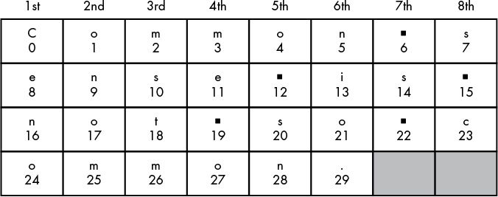
Basic Columnar Technique
Plain Text: Common sense is not so common.
Key: 8 (Number of columns)
Cipher text: Cenoonommstmme oo snnio. s s c

Slide 3
A Variant of Basic Columnar Technique
Plain Text: Common sense is not so common.
Key Pair: 8 (Number of columns), {3,1,7,2,6,8,5,4} (Reading sequence)
Cipher text: mstmCeno s onomnio.s co snme o

Slide 4
Columnar Technique with Multiple Rounds
ROUND 1
Columnar Technique
Key k₁
ROUND 2
Columnar Technique
Key k₂
Plain Text
Cipher Text

Slide 5
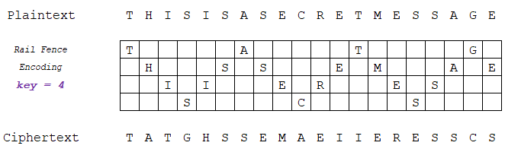
Rail Fence Technique
NOTE: The concept of Reading Sequence and Multiple Round (like Columnar Technique) can also be used here.

Slide 6
Possible Types of Attacks on Encrypted Message
Notes:
This template can be used as a starter file for presenting training materials in a group setting.
Sections
Sections can help to organize your slides or facilitate collaboration between multiple authors. On the Home tab under Slides, click Section, and then click Add Section.
Notes
Use the Notes pane for delivery notes or to provide additional details for the audience. You can see these notes in Presenter View during your presentation.
Keep in mind the font size (important for accessibility, visibility, videotaping, and online production)
Coordinated colors
Pay particular attention to the graphs, charts, and text boxes.
Consider that attendees will print in black and white or grayscale. Run a test print to make sure your colors work when printed in pure black and white and grayscale.
Graphics, tables, and graphs
Keep it simple: If possible, use consistent, non-distracting styles and colors.
Label all graphs and tables.

Slide 7
Possible Types of Attacks
Cipher text only attack: attacker has access only to the ciphertext and aims to decipher the message without any knowledge of the corresponding plaintext or the encryption key.
Known plain text attack: attacker possesses both the plaintext and its corresponding ciphertext. The objective is to deduce the encryption key or algorithm by analyzing the relationship between the known plaintext and ciphertext pairs
Chosen plain text attack: attacker not only has access to the ciphertext but also has the ability to choose specific plaintexts and observe their corresponding ciphertexts. This attack scenario provides the attacker with more control and information compared to a Known Plain Text Attack

Slide 8
Classification of Cryptographic Algorithms (based on Keys)
Symmetric Key Algorithm
Asymmetric Key Algorithm
Notes:
This template can be used as a starter file for presenting training materials in a group setting.
Sections
Sections can help to organize your slides or facilitate collaboration between multiple authors. On the Home tab under Slides, click Section, and then click Add Section.
Notes
Use the Notes pane for delivery notes or to provide additional details for the audience. You can see these notes in Presenter View during your presentation.
Keep in mind the font size (important for accessibility, visibility, videotaping, and online production)
Coordinated colors
Pay particular attention to the graphs, charts, and text boxes.
Consider that attendees will print in black and white or grayscale. Run a test print to make sure your colors work when printed in pure black and white and grayscale.
Graphics, tables, and graphs
Keep it simple: If possible, use consistent, non-distracting styles and colors.
Label all graphs and tables.

Slide 9
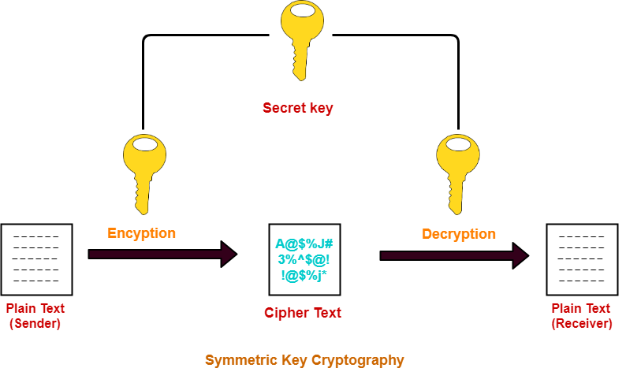
Symmetric Key Algorithm

Slide 10
Problems with Symmetric Key Algorithms
A large number of distinct keys are required.
For n persons, the number of keys required is n*(n-1)/2.
Exchange of key is a big issue.

Slide 11
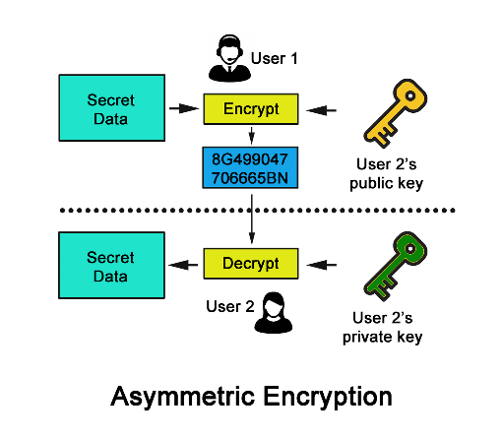
Asymmetric Key Algorithm

Slide 12
Symmetric Key Encryption: Symmetric key encryption, or secret-key cryptography, uses the same key for both the encryption and decryption processes. The key must be kept secret between communicating parties to maintain the confidentiality of the communication.
Characteristics:
Fast and efficient for large amounts of data.
Key distribution between parties can be a challenge.
Examples include DES (Data Encryption Standard) and AES (Advanced Encryption Standard).
Asymmetric Key Encryption: Asymmetric key encryption, or public-key cryptography, employs a pair of keys: a public key for encryption and a private key for decryption. Information encrypted with the public key can only be decrypted with the corresponding private key and vice versa.
Characteristics:
Facilitates secure key exchange without requiring a prior secure communication channel.
Slower than symmetric encryption for large data.
Commonly used for secure communication, digital signatures, and key exchange.
Examples include RSA (Rivest–Shamir–Adleman) and ECC (Elliptic Curve Cryptography).

Slide 13
Symmetric Vs. Asymmetric Key Algorithm
Same key is used for both encryption and decryption in symmetric key algorithm whereas two different but related keys are used in asymmetric key algorithm, one for encryption and another for decryption.
For n persons, the number of keys required is n*(n-1)/2 for symmetric key algorithm whereas it is 2*n for asymmetric key algorithm.
Key exchange is not a problem of asymmetric key algorithm unlike symmetric key algorithm.
Symmetric key algorithms are faster than asymmetric key algorithms.

Slide 14
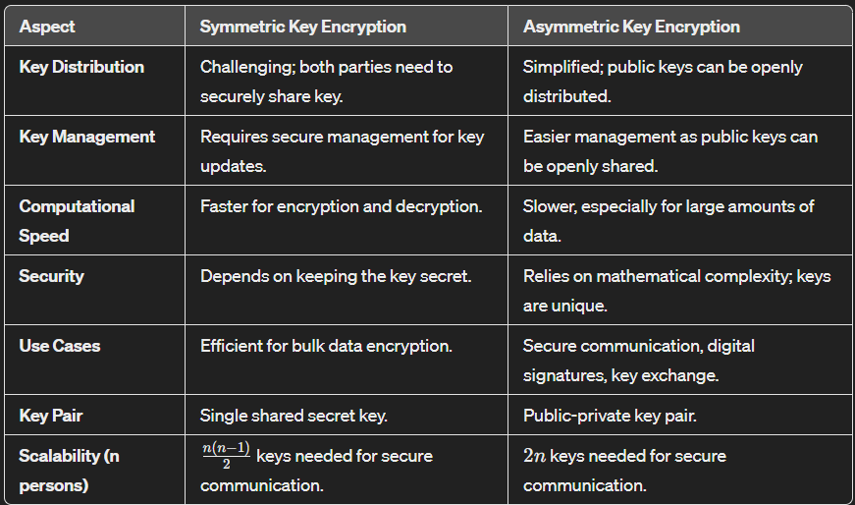

Slide 15
Topics for Self-Study
Two Substitution Techniques
(1) Playfair Cipher
(2) Hill Cipher
Key Range and Size
How are they related with cryptanalysis / measuring the strength of a cryptographic algorithm?

Slide 16
Next Topic
Diffie-Hellman Key Exchange / Agreement Algorithm

Slide 17
Thank You

